Slide 1
Introduction to Object-Relational Mapping for DBAs
Chris Cumming Saturday Morning Productions
Notes:
I’m a developer that’s worked a lot with databases.

Slide 2
What is Object-Relational Mapping (ORM)?
Wikipedia Definition:
Object-relational mapping (ORM, O/RM, and O/R mapping tool) in computer science is a programming technique for converting data between incompatible type systems using object-oriented programming languages. This creates, in effect, a "virtual object database" that can be used from within the programming language. There are both free and commercial packages available that perform object-relational mapping, although some programmers opt to construct their own ORM tools.
My Definition:
Maps database tables to classes.
Notes:
Ask who is familiar with ORMs? Who is familiar with object orientated programing?

Slide 3
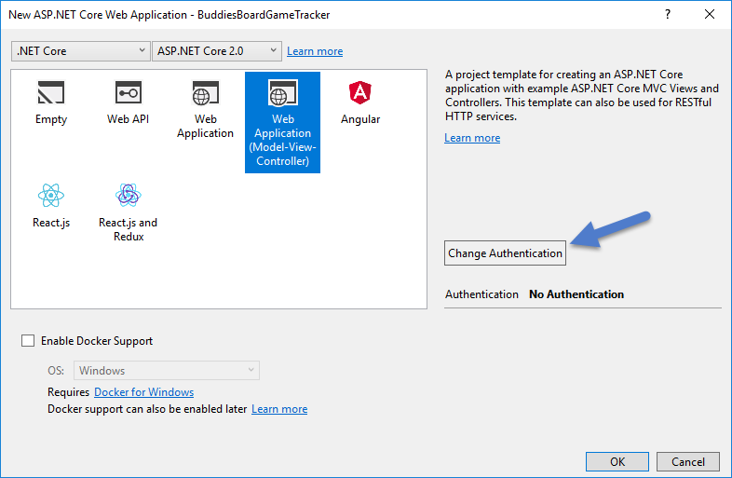
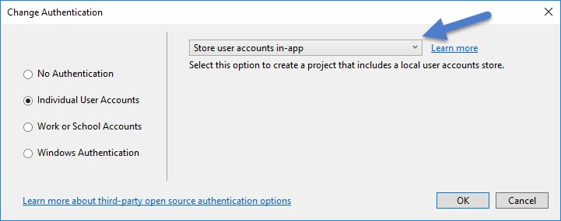
Bud the developer creates a new application with authentication
Notes:
This talk we will follow Bud as he creates a new application that uses Microsofts ORM Entity Framework.
Creating a new application with authentication should create the authentication logic for him and also store the credentials somewhere. Bud knows it’s a database but doesn't really care.

Slide 4
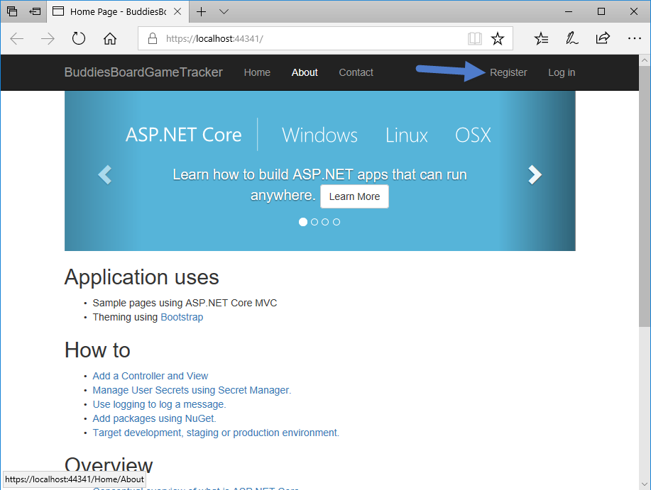
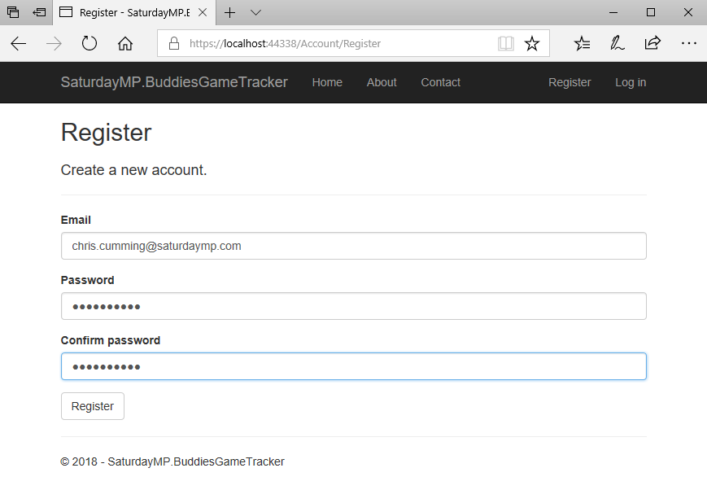
Bud runs the application
Notes:
Before adding any of his own logic Bud tries running the application. It runs and he tries to create a new user.

Slide 5
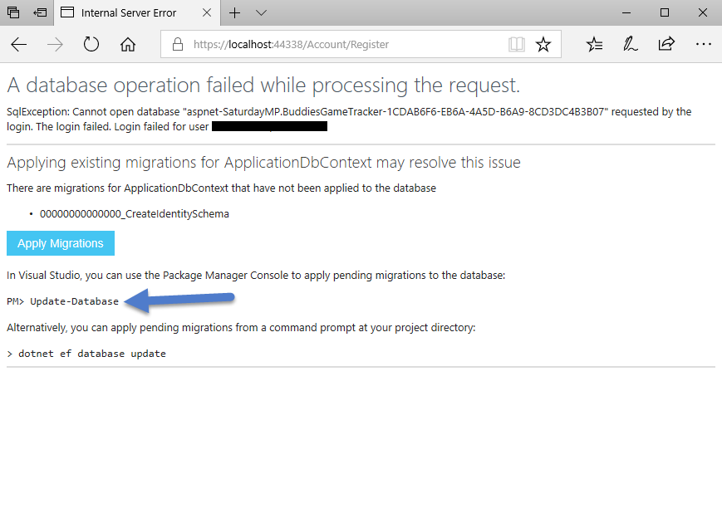
But the application raises an error
Notes:
But the application raises an error. What is going on? Says something about running migrations.

Slide 6
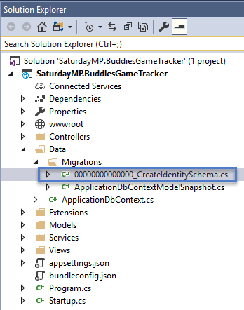
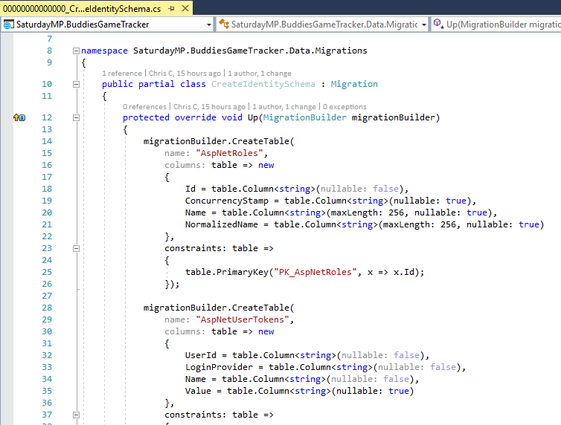
What is a migration?
A file that describes changes to make to the database
Can be auto generated or manually created
Usually not written in SQL
ORM tracks which migrations need to be run
Notes:
Usually for schema changes but can be used for adding data.
Describes changes for both up and down operations. Some down operations can be
destructive.
Auto generated use a process like SQL compare to generate the changes. That said migration files usually aren’t as large as SQL Compare files.
Usually written in a non-SQL language that is later translated to SQL. Allows the migration to run against different databases.
There is a table in the database that tracks which migrations have been run. Migrations are run in order.

Slide 7
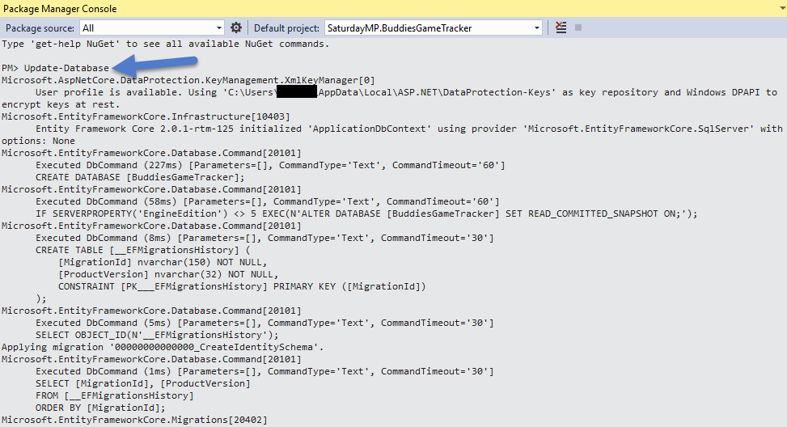
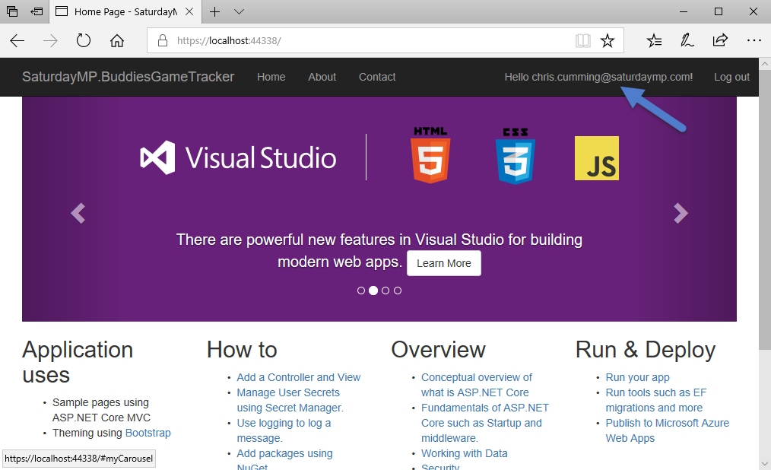
Bud runs the migration and can now create users

Slide 8
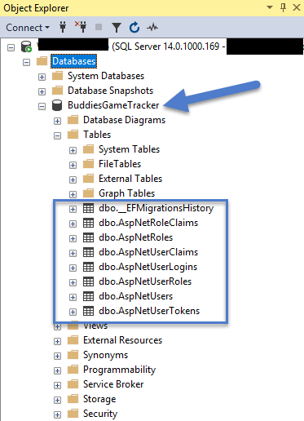
Bud doesn’t look at the database but omnipotent DBAs do
The migration created the database.
It also created the authentication tables.
Bud didn’t have to open SQL Server or run a script.
Notes:
From a developer point of view this is great. Bud didn’t have to write a single line of SQL. He didn’t even have to open up SQL Server, the database was just magically created.
This is just the beginning. Later Bud will create more tables in code to track what buddies have which played which games. He will do this without writing DDL and access the data with little to no SQL.

Slide 9

Don’t panic, migrations can create indexes
Notes:
Migrations can create indexes, keys, etc.

Slide 10
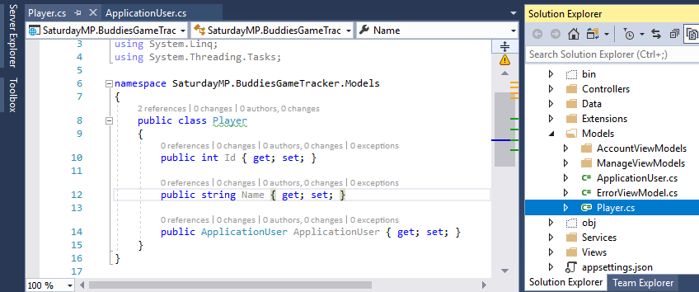
Bud creates the player class

Slide 11
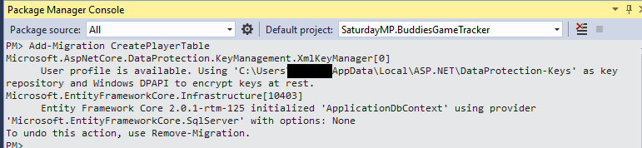
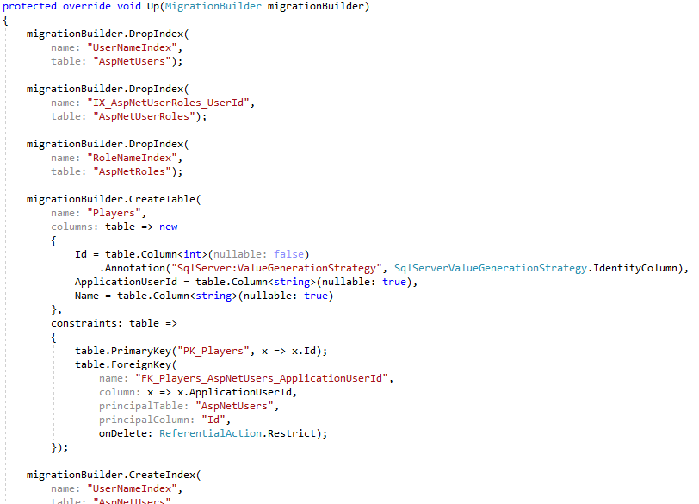
He creates the migration
Notes:
This creates the <timestamp>_CreatePlayerTable file. If we open it up we see it creates the Player table and also a foreign key relationship to the ApplicationUser which maps to the AspNetUsers table.

Slide 12
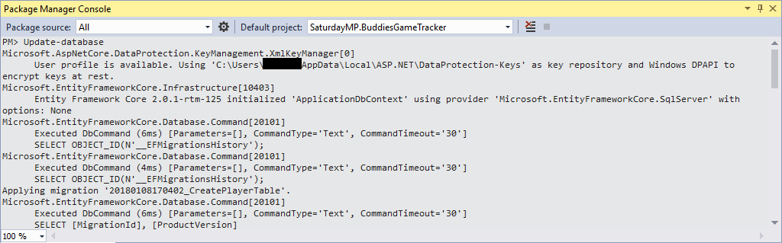
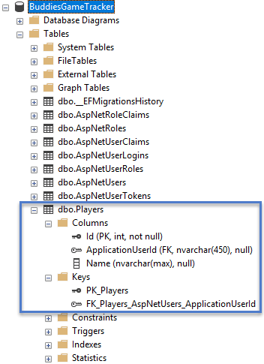
Then runs the migration
Notes:
Now if we look in the database we find the new Players table, notice it’s plural, and it has a foreign key to the AspNetUsers table.
OK, enough of following Bud, we are running out of lightning time. Lets talk about why Bud would want to use an ORM tool such as Entity Framework.

Slide 13
Why Developers Use ORMs (i.e. their biggest strength)
[Shelock] His The developer’s ignorance was remarkable as his knowledge. Of contemporary literature, philosophy and politics he [or she] appeared to know next to nothing. My surprise reached a climax, however, when I found incidentally that he [or she] was ignorant of the Copernican Theory database design.
“You appear to be astonished” he said, smiling at my expression of surprise. “Now that I do know it I shall do my best to forget it.”
“To forget it!”
… <Developer gives long speech about how a developer’s brain is like an attic and only hold so much information>…
“But the Solar System Database!” [Watson] I protested.
“What the deuce is it to me?” he interrupted impatiently: “you say that we go around the sun store data in a database. If we went round the moon stored the data on a stone tablet it would not make a pennyworth of difference to me or to my work”.
Notes:
Finally the biggest strength of a ORM is abstraction of data access. It lets developers focus on the business logic and GUI of the application. Data access is this magic thing that just happens.
Actually that’s not 100% true. Like all abstractions ORMs leak so the developer has to know something about the underlying database but for those brief few moments the developer has one less thing to think about. As Sherlock Holmes put it so eloquently said about developers:
Good developers are good at using abstractions. They create abstractions in code through functions, classes. and layers such as the GUI layer, business layer, etc. An abstraction lets them to temporarily “forget” about the rest of the application and focus on the part they are working on.

Slide 14
Why DBAs dislike ORMs (i.e. their biggest weaknesses)
Biggest weakness is also the abstraction.
“With great power abstractions comes great responsibility.”
Common ORM problems that affect DBAs:
N+1 Select
Select unneeded columns
Complex queries
Don’t play well with Views and Stored Procedures

Slide 15

How DBAs and ORMs can work together
Let the ORM generate schema changes but review them
Let the ORM access tables directly
Adapt the ORM’s naming schema
Don’t worry about being made obsolete
Educate bad developers, if you can
Notes:
Let the ORM generate schema changes but make sure to review them. The developer might not realize that renaming the column caused the column to be dropped and recreated resulting in data loss.
Let the ORM access the tables directly. Only force access threw a view or stored procedure if there is a good reason.
Don’t be afraid to adapt the ORM’s naming schema. An ORM will often assume things like ID is the primary key column, table names are plural, foreign keys are <tablename>ID, etc. If you can’t adopt the ORM’s preferred naming scheme then at least be consistent in your naming.
Don’t worry about being made redundant. ORMs can do some of the work DBAs used to do but not all of it and as we pointed out above ORM generated SQL should still be reviewed. Also ORMs can’t do the A part of DBA (i.e. they don’t backup your database, secure it, create RAID arrays, etc).
If you work with bad developers try to educate them. They might just be naive. If you can’t educate the developers and management won’t help you don’t be afraid to move on. Life is too short to…<fill in the blank>.

